Slide 1



Business report template
Designed by journey

Slide 2
CONTENT
Part One
Part Two
Part Three
Part Four
Use, by you or one client, in a single end product which end users are not charged for.
Use, by you or one client, in a single end product which end users are not charged for.
Use, by you or one client, in a single end product which end users are not charged for.
Use, by you or one client, in a single end product which end users are not charged for.

Slide 3
CONTENT
Part One
Part Two
Part Three
Part Four
Use, by you or one client, in a single end product which end users are not charged for.
Use, by you or one client, in a single end product which end users are not charged for.
Use, by you or one client, in a single end product which end users are not charged for.
Use, by you or one client, in a single end product which end users are not charged for.

Slide 4

ABOUT COMPANY
No matter how bad your heart has been broken, the world doesn’t stop for your grief. The sun comes right back up the next day. No matter how bad your heart has been broken, the world doesn’t stop for your grief. The sun comes right back up the next day.

Slide 5
1
ADD THE TITLE HERE
Use, by you or one client, in a single end product which
Main Keyword
Main Keyword
Main Keyword
No matter how bad your heart has been broken, the world doesn’t stop for your grief. The sun comes right back up the next day. No matter how bad your heart has
No matter how bad your heart has been broken, the world doesn’t stop for your grief. The sun comes right back up the next day. No matter how bad your heart has
No matter how bad your heart has been broken, the world doesn’t stop for your grief. The sun comes right back up the next day. No matter how bad your heart has

Slide 6
1
ADD THE TITLE HERE
Use, by you or one client, in a single end product which
1
2
Main keyword
Main keyword
No matter how bad your heart has been broken, the world doesn’t stop for your grief. The sun comes right back up the next day. No matter how bad your heart has
No matter how bad your heart has been broken, the world doesn’t stop for your grief. The sun comes right back up the next day. No matter how bad your heart has
4
3
Main keyword
Main keyword
No matter how bad your heart has been broken, the world doesn’t stop for your grief. The sun comes right back up the next day. No matter how bad your heart has
No matter how bad your heart has been broken, the world doesn’t stop for your grief. The sun comes right back up the next day. No matter how bad your heart has

Slide 7
1
ADD THE TITLE HERE
Use, by you or one client, in a single end product which
80%
60%
70%
Main keyword
Main keyword
Main keyword
No matter how bad your heart has been broken, the world doesn’t stop for your grief. The sun comes right back up the next
No matter how bad your heart has been broken, the world doesn’t stop for your grief. The sun comes right back up the next
No matter how bad your heart has been broken, the world doesn’t stop for your grief. The sun comes right back up the next

Slide 8
1
ADD THE TITLE HERE
Use, by you or one client, in a single end product which
Text here to add title
Main keyword
No matter how bad your heart has been broken, the world doesn’t stop for your grief. The sun comes right back up the next day. No matter how bad your heart hasNo matter how bad your heart has been broken, the world doesn’t stop for your grief. The sun comes right back up the next day.
No matter how bad your heart hasNo matter how bad your heart has been broken, the world doesn’t stop for your grief. The sun comes right back up the next day. No matter how bad your heart hasNo matter how bad your heart has been broken, the world doesn’t stop for your grief. The sun comes right back up the next day. No matter how bad your heart has
Main keyword
Main keyword

Slide 9
CONTENT
Part One
Part Two
Part Three
Part Four
Use, by you or one client, in a single end product which end users are not charged for.
Use, by you or one client, in a single end product which end users are not charged for.
Use, by you or one client, in a single end product which end users are not charged for.
Use, by you or one client, in a single end product which end users are not charged for.

Slide 10
2
ADD THE TITLE HERE
Use, by you or one client, in a single end product which
Main keyword
Main keyword
Main keyword
Main keyword
No matter how bad your heart has been broken, the world doesn’t stop for your grief. The sun comes right back up the next day. No matter how bad your heart has been broken, the world doesn’t stop for your grief. The sun comes right back up the next day.

Slide 11
2
ADD THE TITLE HERE
Use, by you or one client, in a single end product which
10%
25%
45%
title
title
title
No matter how bad your heart has been broken, the world doesn’t stop for your grief. The sun comes right back up the next day. No matter how bad your heart has been broken, the world doesn’t stop for your grief. The sun comes right back up the next day. No matter how bad your heart has been broken, the world doesn’t stop for your grief. The sun comes right back up the next day. No matter how bad your heart has been broken, the world doesn’t stop for your grief. The sun comes right back up the next day.

Slide 12
2
ADD THE TITLE HERE
Use, by you or one client, in a single end product which
Main keyword
No matter how bad your heart has been broken, the world doesn’t stop for your grief. The sun comes right back up the next day. No matter how bad your heart hasNo matter how bad your heart has been broken, the world doesn’t stop for your grief. The sun comes right back up the next day.
No matter how bad your heart hasNo matter how bad your heart has been broken, the world doesn’t stop for your grief. The sun comes right back up the next day. No matter how bad your heart hasNo matter how bad your heart has been broken, the world doesn’t stop for your grief. The sun comes right back up the next day. No matter how bad your heart has
Main keyword
Main keyword

Slide 13
CONTENT
Part One
Part Two
Part Three
Part Four
Use, by you or one client, in a single end product which end users are not charged for.
Use, by you or one client, in a single end product which end users are not charged for.
Use, by you or one client, in a single end product which end users are not charged for.
Use, by you or one client, in a single end product which end users are not charged for.

Slide 14

3
ADD THE TITLE HERE
Use, by you or one client, in a single end product which
No matter how bad your heart has been broken, the world doesn’t stop for your grief. The sun comes right back up
No matter how bad your heart has been broken, the world doesn’t stop for your grief. The sun comes right back up
No matter how bad your heart has been broken, the world doesn’t stop for your grief. The sun comes right back up
No matter how bad your heart has been broken, the world doesn’t stop for your grief. has been broken, the world grief. The sun comes right

Slide 15



3
ADD THE TITLE HERE
Use, by you or one client, in a single end product which
Main keyword
Main keyword
Main keyword
No matter how bad your heart has been broken, the world doesn’t stop for your grief. The sun comes right back up the next day. No matter how bad your heart has
No matter how bad your heart has been broken, the world doesn’t stop for your grief. The sun comes right back up the next day. No matter how bad your heart has
No matter how bad your heart has been broken, the world doesn’t stop for your grief. The sun comes right back up the next day. No matter how bad your heart has

Slide 16
CONTENT
Part One
Part Two
Part Three
Part Four
Use, by you or one client, in a single end product which end users are not charged for.
Use, by you or one client, in a single end product which end users are not charged for.
Use, by you or one client, in a single end product which end users are not charged for.
Use, by you or one client, in a single end product which end users are not charged for.

Slide 17

ADD THE TITLE HERE
Use, by you or one client, in a single end product which
1
No matter how bad your heart has been broken, the world doesn’t stop for your grief. The sun comes right
2
No matter how bad your heart has been broken, the world doesn’t stop for your grief. The sun comes right
3
No matter how bad your heart has been broken, the world doesn’t stop for your grief. The sun comes right

Slide 18
4
ADD THE TITLE HERE
Use, by you or one client, in a single end product which
No matter how bad your heart has been broken, the world doesn’t stop for your grief. The sun comes right back up the next day. No matter how bad your heart hasNo matter how bad your heart has been broken, the world doesn’t stop for your grief.
keyword
No matter how bad your heart has been broken, the world doesn’t stop for your grief. The sun comes right back up the next day. No matter how bad your heart hasNo matter how bad your heart has been broken, the world doesn’t stop for your grief.
keyword
No matter how bad your heart has been broken, the world doesn’t stop for your grief. The sun comes right back up the next day. No matter how bad your heart hasNo matter how bad your heart has been broken, the world doesn’t stop for your grief.
keyword

Slide 19
Thank you for watching
Designed by journey

Slide 20
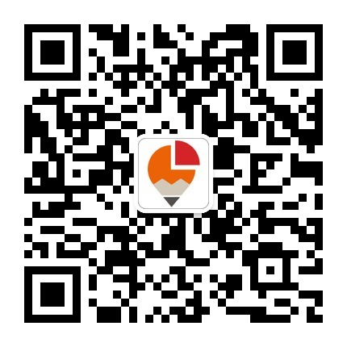
本作品版权归上海锐普广告有限公司PPT研究院作者所有
购买和下载者只是获得了使用授权，并不能获得著作权
任单位和个人不得以任何形式销售、传播本作品
转载请注明出处，保留本版权页，请勿以身试法

Slide 21
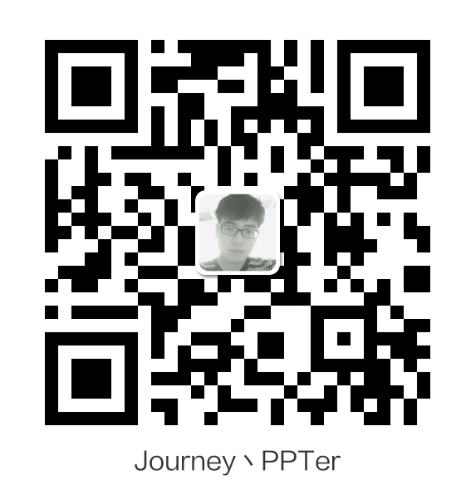
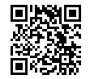
请大家支持我，我才能给大家更好的免费作品
演界网

Slide 22
www.51pptmoban.com 授权转载

